Slide 1
Addition with Fractions

Slide 2
Words and Math
Before you begin instruction, you may need to review the different ways the operation of addition is referred to in word problems
Some key phrases to look for include:
Added to
Plus
Sum
More than
The contents of this content module were developed by special educator Bethany Smith, PhD and validated by content expert Drew Polly, PhD at University of North Carolina at Charlotte under a grant from the Department of Education (PR/Award #: H373X100002, Project Officer, Susan.Weigert@Ed.gov). However, the contents do not necessarily represent the policy of the Department of Education and no assumption of endorsement by the Federal government should be made

Slide 3
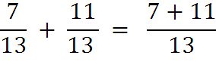
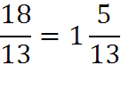
Adding fractions with the same denominator: An example
To add fractions with the same denominator, you add the numerators together while keeping the denominator
To simplify the improper fraction
Divide 18 by 13
Record the whole number (the number before the decimal)
Subtract 13 from 18 to find what is left over
Record that number as the new numerator for the fraction
An improper fraction
The contents of this content module were developed by special educator Bethany Smith, PhD and validated by content expert Drew Polly, PhD at University of North Carolina at Charlotte under a grant from the Department of Education (PR/Award #: H373X100002, Project Officer, Susan.Weigert@Ed.gov). However, the contents do not necessarily represent the policy of the Department of Education and no assumption of endorsement by the Federal government should be made

Slide 4
Adding fractions with different denominators
Step 1: find a common denominator
Method 1- multiply one denominator by the other
If you use this method, after you finishing adding, you may need to reduce the fraction to it’s simplest form
For example,
Method 2- find the least common denominator
If you use this method, students may benefit from having a chart already showing multiples of numbers 1-10 so they can select the correct multiple
The contents of this content module were developed by special educator Bethany Smith, PhD and validated by content expert Drew Polly, PhD at University of North Carolina at Charlotte under a grant from the Department of Education (PR/Award #: H373X100002, Project Officer, Susan.Weigert@Ed.gov). However, the contents do not necessarily represent the policy of the Department of Education and no assumption of endorsement by the Federal government should be made

Slide 5
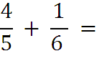
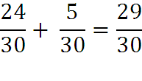
Adding fractions with different denominators: An example
Using method 1
Multiply 5 by 6 to get new denominator
In this case, the sum cannot be simplified further so there is no need to reduce the fraction
The contents of this content module were developed by special educator Bethany Smith, PhD and validated by content expert Drew Polly, PhD at University of North Carolina at Charlotte under a grant from the Department of Education (PR/Award #: H373X100002, Project Officer, Susan.Weigert@Ed.gov). However, the contents do not necessarily represent the policy of the Department of Education and no assumption of endorsement by the Federal government should be made

Slide 6
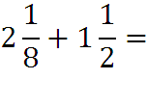
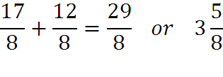
Adding fractions with different denominators: An example
Using method 2
Step 1: Convert mixed numbers to improper fractions
Step 2: 8 is the least common denominator
Step 3: add numerators
Step 4: Convert improper fraction back to a mixed number (See slide 3)
The contents of this content module were developed by special educator Bethany Smith, PhD and validated by content expert Drew Polly, PhD at University of North Carolina at Charlotte under a grant from the Department of Education (PR/Award #: H373X100002, Project Officer, Susan.Weigert@Ed.gov). However, the contents do not necessarily represent the policy of the Department of Education and no assumption of endorsement by the Federal government should be made

Slide 7
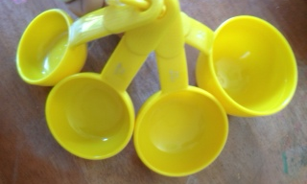
Ideas for application
Begin adding my manipulating concrete objects
Use measuring cups in the context of cooking
Fill the 2/3rd measuring cup with water, fill the ¼ measuring cup with water, and pour into one of the large measuring cups to see how much water there was after adding them
The contents of this content module were developed by special educator Bethany Smith, PhD and validated by content expert Drew Polly, PhD at University of North Carolina at Charlotte under a grant from the Department of Education (PR/Award #: H373X100002, Project Officer, Susan.Weigert@Ed.gov). However, the contents do not necessarily represent the policy of the Department of Education and no assumption of endorsement by the Federal government should be made

Slide 8
Making connections
Adding fractions address the following 4th and 5th grade Core Content Connectors
4.NO.2h1 Add and subtract fractions with like denominators of (2,3,4 or 8)
4.NO.2h2 Add and subtract fractions with like denominators (2,3,4 or 8) using representations
4.NO.2h3 Solve word problems involving addition and subtraction of fractions with like denominators (2,3,4 or 8)
5.NO.2b1 Add and subtract fractions with unlike denominators by replacing fractions with equivalent fractions (identical denominators)
5.NO.2b2 Add or subtract fractions with unlike denominators
The contents of this content module were developed by special educator Bethany Smith, PhD and validated by content expert Drew Polly, PhD at University of North Carolina at Charlotte under a grant from the Department of Education (PR/Award #: H373X100002, Project Officer, Susan.Weigert@Ed.gov). However, the contents do not necessarily represent the policy of the Department of Education and no assumption of endorsement by the Federal government should be made

