Slide 1
Linear Functions
The contents of this content module were developed by special educator Bethany Smith, PhD and validated by content expert Drew Polly, PhD at University of North Carolina at Charlotte under a grant from the Department of Education (PR/Award #: H373X100002, Project Officer, Susan.Weigert@Ed.gov). However, the contents do not necessarily represent the policy of the Department of Education and no assumption of endorsement by the Federal government should be made

Slide 2
What is a function?
A function is a special mathematical operation demonstrating the relationship between the input (also called domain) and output (also called range) of an expression
For example,
The relationship between number of gallons of gas purchased and the total cost of the purchase (see the chart below)
Note: the relationship is constant
Input: Number of gallons | Relationship: $3.00 per gallon | Output: Total purchase
1 | X $3.00 | $3.00
2 | X $3.00 | $6.00
3 | X $3.00 | $9.00
4 | X $3.00 | $12.00
The contents of this content module were developed by special educator Bethany Smith, PhD and validated by content expert Drew Polly, PhD at University of North Carolina at Charlotte under a grant from the Department of Education (PR/Award #: H373X100002, Project Officer, Susan.Weigert@Ed.gov). However, the contents do not necessarily represent the policy of the Department of Education and no assumption of endorsement by the Federal government should be made

Slide 3
What is a function?
Unlike other mathematical relationships, in functions
The relationship must be one, consistent regardless of the input value
Function must be true for every possible input value
input
output
This is a function because there is only one output for each input
The contents of this content module were developed by special educator Bethany Smith, PhD and validated by content expert Drew Polly, PhD at University of North Carolina at Charlotte under a grant from the Department of Education (PR/Award #: H373X100002, Project Officer, Susan.Weigert@Ed.gov). However, the contents do not necessarily represent the policy of the Department of Education and no assumption of endorsement by the Federal government should be made

Slide 4
What is a function?
input
output
This is a function because there is only one arrow coming from each of the input
input
output
This is a NOT function because there is more than one arrow coming from one of the input values
The contents of this content module were developed by special educator Bethany Smith, PhD and validated by content expert Drew Polly, PhD at University of North Carolina at Charlotte under a grant from the Department of Education (PR/Award #: H373X100002, Project Officer, Susan.Weigert@Ed.gov). However, the contents do not necessarily represent the policy of the Department of Education and no assumption of endorsement by the Federal government should be made

Slide 5
What is a function?
Another method to tell if something is a function is called the “vertical line test”
Function: the vertical line only crosses one point
Function: the vertical line only crosses one point
NOT a function: the vertical line crosses more than one point
The contents of this content module were developed by special educator Bethany Smith, PhD and validated by content expert Drew Polly, PhD at University of North Carolina at Charlotte under a grant from the Department of Education (PR/Award #: H373X100002, Project Officer, Susan.Weigert@Ed.gov). However, the contents do not necessarily represent the policy of the Department of Education and no assumption of endorsement by the Federal government should be made

Slide 6
What is a linear function?
Any function that when the input and output are graphed, the input/output pairs form a line
Using the gas example from the previous slide
Input: Number of gallons | Relationship: $3.00 per gallon | Output: Total purchase
1 | X $3.00 | $3.00
2 | X $3.00 | $6.00
3 | X $3.00 | $9.00
4 | X $3.00 | $12.00
Note: The input the x-coordinate and the output is the y-coordinate
The contents of this content module were developed by special educator Bethany Smith, PhD and validated by content expert Drew Polly, PhD at University of North Carolina at Charlotte under a grant from the Department of Education (PR/Award #: H373X100002, Project Officer, Susan.Weigert@Ed.gov). However, the contents do not necessarily represent the policy of the Department of Education and no assumption of endorsement by the Federal government should be made

Slide 7
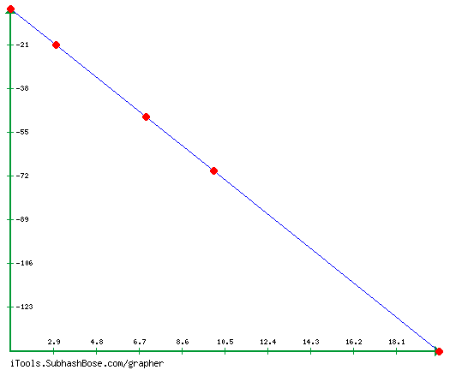
Is the function linear?
Input (x-coord) | Relationship | Output (y-coord)
1 |  | -7
3 |  | -21
7 |  | -49
10 |  | -70
20 |  | -140
Method 1: is the relationship consistent?
Method 2: graph the coordinates
Input (x-coord) | Relationship | Output (y-coord)
1 | X -7 | -7
3 | X-7 | -21
7 | X-7 | -49
10 | X-7 | -70
20 | X-7 | -140
Answer: Yes, the relationship is consistent
Answer: Yes, the graphed coordinates are linear
The contents of this content module were developed by special educator Bethany Smith, PhD and validated by content expert Drew Polly, PhD at University of North Carolina at Charlotte under a grant from the Department of Education (PR/Award #: H373X100002, Project Officer, Susan.Weigert@Ed.gov). However, the contents do not necessarily represent the policy of the Department of Education and no assumption of endorsement by the Federal government should be made

Slide 8
Linear functions: An example
The standard from for linear equations is
Y=ax +b
Problem: Graph the linear function y=2x +1
Step One: create a table with input and determine output values
Input | Output
2 | 2(2)+1= 5
1 | 2(1) +1= 3
0 | 2(0)+1= 1
-1 | 2(-1)+1= -1
The input and output values are the ordered pairs to graph

Slide 9
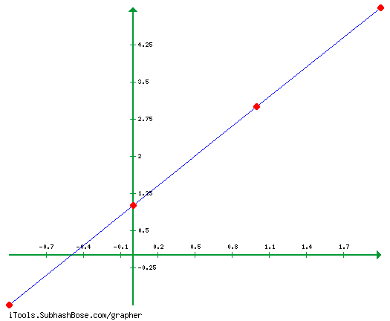
Linear functions: An example
Step 2: Graph the ordered pairs
Is the graph linear?
YES, THIS IS A LINEAR FUNCTION

Slide 10
Is the function linear: Graphing calculators
In most classrooms, students may not graphs functions by hand (especially in high school). Therefore, it may be beneficial to create a task-anlaysis for entering these equations.
May also want to consider color-coding buttons and terms in the equation to assist student with limited numeracy skills

Slide 11
Ideas for application
Create personally-relevant word problems or contexts
The amount you pay for gas and the number of gallons
How much electricity you use and the total of your monthly bill
The contents of this content module were developed by special educator Bethany Smith, PhD and validated by content expert Drew Polly, PhD at University of North Carolina at Charlotte under a grant from the Department of Education (PR/Award #: H373X100002, Project Officer, Susan.Weigert@Ed.gov). However, the contents do not necessarily represent the policy of the Department of Education and no assumption of endorsement by the Federal government should be made

Slide 12
Making connections
Linear functions with exponents addresses the middle and high school Core Content Connectors of
6.PRF.2a4 Analyze the relationship between the dependent and independent variables using graphs and tables, and relate these to the equation
8.PRF.2c Given two graphs, describe the function as linear and not linear
8.PRF.2e1 Distinguish between functions and non-functions, using equations, graphs or tables
The contents of this content module were developed by special educator Bethany Smith, PhD and validated by content expert Drew Polly, PhD at University of North Carolina at Charlotte under a grant from the Department of Education (PR/Award #: H373X100002, Project Officer, Susan.Weigert@Ed.gov). However, the contents do not necessarily represent the policy of the Department of Education and no assumption of endorsement by the Federal government should be made

