Slide 1
1
2
3
4
5
6
7
8
8
9
10
11
12
13
14
15
16
16
17
18
19
20
21
22
23
24
24
25
26
27
28
29
30
31
32
32
33
34
35
36
37
38
39
40
40
41
42
43
44
45
46
47
48
48
49
50
51
52
53
54
55
56
56
57
58
59
60
61
62
63
64
64

Slide 2
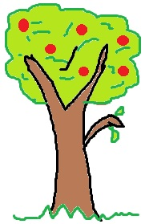
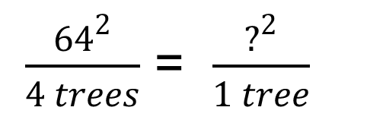
16
4
8
12
8ft
1
2
16ft²
8ft
1
2
3
4
16ft²
$\frac{{64}^{2}}{4 trees}$ = $\frac{?^{2}}{1 tree}$
3
4

Slide 3
8ft
+ 4 =
12ft
+ 4 =
16ft
1
2
3
4
1
2
3
4
8ft
= 4 +
12ft
= 4 +
1
2
3
16ft
4
1
2
3
4

Slide 4
Length of Orchard One + 4 = Length of Orchard Two
x + 4 = 8
Rate of change
1
2
3
4
4ft
8ft
1
2
3
4
5
6
7
8
1
2
3
4
2
4ft
3
4
8ft
1
5
2
6
3
7
4
8

Slide 5
1
2
3
4
Length of Orchard Four + rate of change = Length of Orchard Five
16ft
+ 4 =
20ft
1 | 2 | 3 | 4 | 5 | 6 | 7 | 8 | 9 | 10 | 11 | 12 | 13 | 14 | 15 | 16
2
3
4
5
6
7
8
9
10
11
12
13
14
15
16
17 | 18 | 19 | 20
16ft + 4ft = 20ft
1
2
3
4
16ft
= 4 +
17
18
19
20
20ft
1
2
3
4

Slide 6
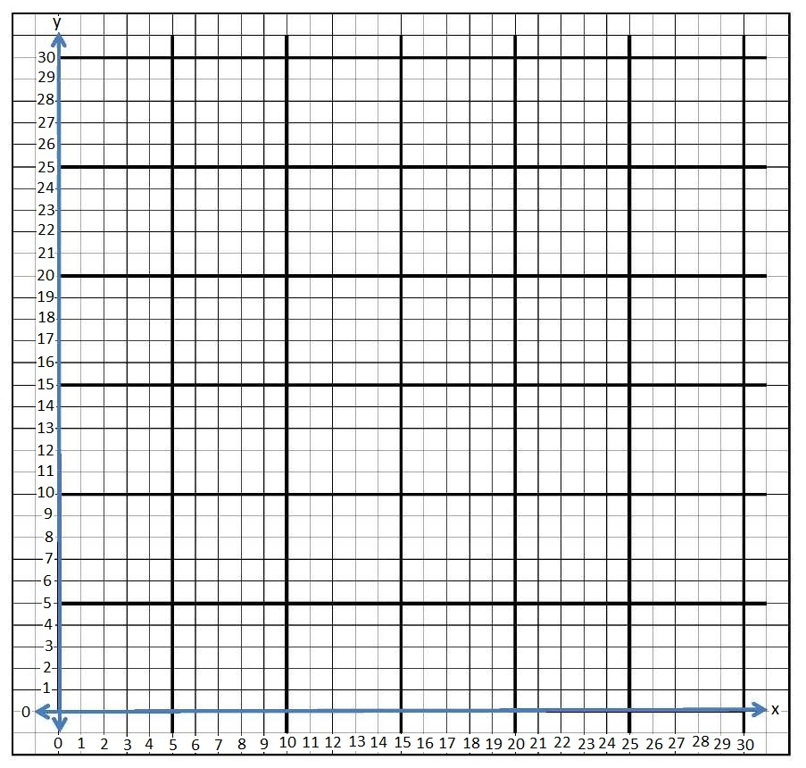
Orchard Number | Length of Each Side (feet) X | Area of Each Orchard (ft²) | Number of Apple Trees y
1st | 4 | 16 ft² | 1
2nd | 8 | 64 ft² | 4
3rd | 12 | 144 ft² | 9
4th | 16 | 256 ft² | 16
5th | 20 | 400 ft² | 25

Slide 7
25% or ¼ of Orchard #2
½ of Orchard #2
12 ft.
Unit Length for
25% or ¼ of Orchard #2
1
2
3
12 ft.

Slide 8
1
2
3
4
Length of Orchard #3 + 25% of Orchard #3 = Length of Casey and Liz’s Orchard
12ft
+ 3 =
15ft
1 | 2 | 3 | 4 | 5 | 6 | 7 | 8 | 9 | 10 | 11 | 12
2
3
4
5
6
7
8
9
10
11
12
1
2
3
12ft + 3ft = 15ft
13 | 14 | 15
12ft
= 3 +
1
13
14
15
15ft
2
3

