Slide 1
How can you support student understanding of text structure?
Most nonfiction texts contain language that signals the reader about how the text is structured. For example, words such as while, but, either, and unlike, signal the reader that the author is comparing and contrasting information. Words such as because and since signal a cause and effect structure. Adjectives and prepositional phrases often signal a descriptive text structure.
Call students’ attention to how the author uses language to organize the text, and discuss with students why the author might have chosen a particular structure to communicate the content.
Once the teacher has modeled the text structure, students can follow the organizing pattern to identify important events, concepts and ideas. Students should also be taught the signal words that alert them to text structure.

Slide 2
Teaching Text Structures
Show examples of paragraphs that correspond to each text structure.
Examine topic sentences that clue the reader to a specific structure.
Model the writing of a paragraph that uses a specific text structure.
Have students try writing paragraphs that follow a specific text structure.
Have students diagram these structures using a graphic organizer.

Slide 3
Example
Kansas and Hawaii are similar in some ways. Both are states in which farming is a major industry. They are also different, however. Hawaii is a tropical island, while Kansas is landlocked in the middle of the country.

Slide 4
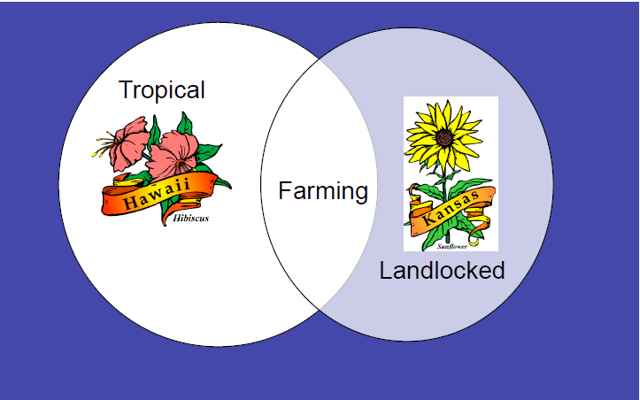
Example

Slide 5
Teaching Text Structures
Have students sort a variety of paragraphs from your content area by text structures.
Begin by sorting into only one or two groups at a time; work up to all five.
Use signal words to help determine structure.
Work in collaborative groups for this activity.

