Slide 1
Quadratic Functions
The contents of this content module were developed by special educator Bethany Smith, PhD and validated by content expert Drew Polly, PhD at University of North Carolina at Charlotte under a grant from the Department of Education (PR/Award #: H373X100002, Project Officer, Susan.Weigert@Ed.gov). However, the contents do not necessarily represent the policy of the Department of Education and no assumption of endorsement by the Federal government should be made

Slide 2
What is a function?
A function is a special mathematical operation demonstrating the relationship between the input (also called domain) and output (also called range) of an expression
For example,
The relationship between number of gallons of gas purchased and the total cost of the purchase (see the chart below)
Note: the relationship is constant
Input: Number of gallons | Relationship: $3.00 per gallon | Output: Total purchase
1 | X $3.00 | $3.00
2 | X $3.00 | $6.00
3 | X $3.00 | $9.00
4 | X $3.00 | $12.00
The contents of this content module were developed by special educator Bethany Smith, PhD and validated by content expert Drew Polly, PhD at University of North Carolina at Charlotte under a grant from the Department of Education (PR/Award #: H373X100002, Project Officer, Susan.Weigert@Ed.gov). However, the contents do not necessarily represent the policy of the Department of Education and no assumption of endorsement by the Federal government should be made

Slide 3
What is a function?
Unlike other mathematical relationships, in functions
The relationship must be one, consistent regardless of the input value
Function must be true for every possible input value
input
output
This is a function because there is only one output for each input
The contents of this content module were developed by special educator Bethany Smith, PhD and validated by content expert Drew Polly, PhD at University of North Carolina at Charlotte under a grant from the Department of Education (PR/Award #: H373X100002, Project Officer, Susan.Weigert@Ed.gov). However, the contents do not necessarily represent the policy of the Department of Education and no assumption of endorsement by the Federal government should be made

Slide 4
What is a function?
input
output
This is a function because there is only one arrow coming from each of the input
input
output
This is a NOT function because there is more than one arrow coming from one of the input values
The contents of this content module were developed by special educator Bethany Smith, PhD and validated by content expert Drew Polly, PhD at University of North Carolina at Charlotte under a grant from the Department of Education (PR/Award #: H373X100002, Project Officer, Susan.Weigert@Ed.gov). However, the contents do not necessarily represent the policy of the Department of Education and no assumption of endorsement by the Federal government should be made

Slide 5
What is a function?
Another method to tell if something is a function is called the “vertical line test”
Function: the vertical line only crosses one point
Function: the vertical line only crosses one point
NOT a function: the vertical line crosses more than one point
The contents of this content module were developed by special educator Bethany Smith, PhD and validated by content expert Drew Polly, PhD at University of North Carolina at Charlotte under a grant from the Department of Education (PR/Award #: H373X100002, Project Officer, Susan.Weigert@Ed.gov). However, the contents do not necessarily represent the policy of the Department of Education and no assumption of endorsement by the Federal government should be made

Slide 6
What is a quadratic function?
Any function that when the input and output are graphed, the input/output pairs form a U-shape called a parabola
Typically written in the form y=ax²+bx+c
a, b, and c are real number and
a does not equal 0
This point is called the vertex
The contents of this content module were developed by special educator Bethany Smith, PhD and validated by content expert Drew Polly, PhD at University of North Carolina at Charlotte under a grant from the Department of Education (PR/Award #: H373X100002, Project Officer, Susan.Weigert@Ed.gov). However, the contents do not necessarily represent the policy of the Department of Education and no assumption of endorsement by the Federal government should be made

Slide 7
Is the function quadratic?
There are many methods to verify whether or not a function is quadratic; however, the remaining slides will only focus on ONE method…..graphing
Specifically, we will discuss graphing by hand and using a graphing calculator
Remember, this is NOT THE ONLY WAY! For information on the other methods, please see a mathematics education professional
The contents of this content module were developed by special educator Bethany Smith, PhD and validated by content expert Drew Polly, PhD at University of North Carolina at Charlotte under a grant from the Department of Education (PR/Award #: H373X100002, Project Officer, Susan.Weigert@Ed.gov). However, the contents do not necessarily represent the policy of the Department of Education and no assumption of endorsement by the Federal government should be made

Slide 8
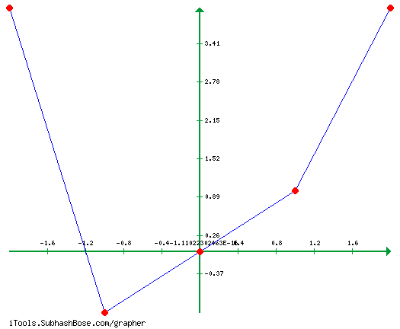
Is the function quadratic: Graph it by hand
f(x) = x²
Step 1: Create a table with input and solve to find output values?
Step 2: graph the coordinates
Input (x-coord) | Output (y-coord)
2 | (2)² = 4
1 | (1)² = 1
0 | (0)² = 0
-1 | (-1)² ⁼ 1
-2 | (-2)² = 4
Answer: Yes, the graphed coordinates form a U-shape with a vertex at (-1,1)
The contents of this content module were developed by special educator Bethany Smith, PhD and validated by content expert Drew Polly, PhD at University of North Carolina at Charlotte under a grant from the Department of Education (PR/Award #: H373X100002, Project Officer, Susan.Weigert@Ed.gov). However, the contents do not necessarily represent the policy of the Department of Education and no assumption of endorsement by the Federal government should be made

Slide 9
Is the function quadratic: Graphing calculators
In most classrooms, students may not graphs quadratic functions by hand (especially in high school). Therefore, it may be beneficial to create a task-analysis for entering these equations.
May also want to consider color-coding buttons and terms in the equation to assist student with limited numeracy skills

Slide 10
Ideas for application
Create personally-relevant word problems or contexts
Solve using graphing calculators
The skills used for entering equations into a graphing calculator could be generalized to data entry on a computer or using a cash register in a retail setting
The contents of this content module were developed by special educator Bethany Smith, PhD and validated by content expert Drew Polly, PhD at University of North Carolina at Charlotte under a grant from the Department of Education (PR/Award #: H373X100002, Project Officer, Susan.Weigert@Ed.gov). However, the contents do not necessarily represent the policy of the Department of Education and no assumption of endorsement by the Federal government should be made

Slide 11
Making connections
Linear functions with exponents addresses the middle and high school Core Content Connectors of
6.PRF.2a4 Analyze the relationship between the dependent and independent variables using graphs and tables, and relate these to the equation
8.PRF.2e1 Distinguish between functions and non-functions, using equations, graphs or tables
H.PRF.2c1 make predictions based on a given model (for example, a weather model, data for athletes over years)
The contents of this content module were developed by special educator Bethany Smith, PhD and validated by content expert Drew Polly, PhD at University of North Carolina at Charlotte under a grant from the Department of Education (PR/Award #: H373X100002, Project Officer, Susan.Weigert@Ed.gov). However, the contents do not necessarily represent the policy of the Department of Education and no assumption of endorsement by the Federal government should be made

