Slide 1
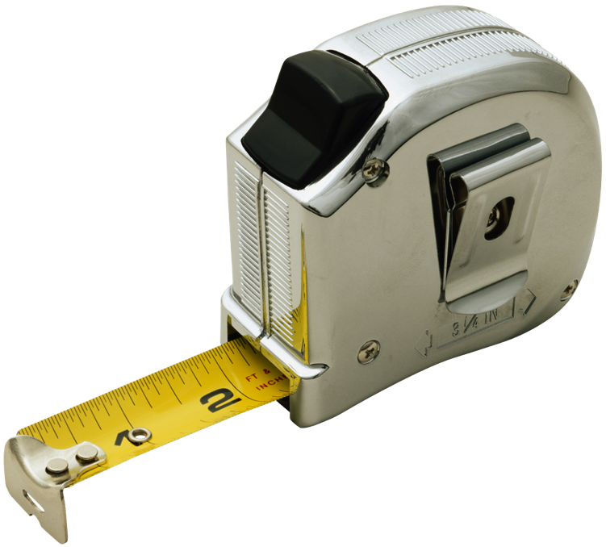
Converting Units Within the Metric System (length)

Slide 2
The Metric System
The metric system does not use feet and inches; it uses meters and centimeters.

Slide 3
“Cent” means “100,” which is why there are 100 centimeters in a meter.
1 meter (m)
10 cm
10 cm
10 cm
10 cm
10 cm
10 cm
10 cm
10 cm
10 cm
10 cm
1 meter (m) = 100 centimeters (cm)
1 x 100 = 100
larger unit
smaller unit
meters to centimeters – MULTIPLY BY 100
Remember: centimeters are smaller units than meters, so it takes more of them to equal a meter, which is why you multiply to convert meters to centimeters.
Notes:
This slide has animation.
1) Point out that meters are much bigger than an centimeters. Tell the students that 1 meter equals 100 centimeters and that 100 centimeters equal 1 meter.
2) Click – Have the students count to 100 as you click and each animated 10-cm square pops up.
3) Click – Explain that to convert a measurement in meters to centimeters, you must multiply by 100. (Click – When you go from a larger unit [click] to a smaller unit [click], you multiply because [click] it takes more of the smaller unit to equal the same amount in the larger unit.)
4) Click – Point out that the prefix “cent” means 100, which is why 100 meters are named a “centimeter.”

Slide 4
Meters to Centimeters – Reference
MULTIPLY
2 meters x 100 = 200 centimeters
3 meters x 100 = 300 centimeters
4 meters x 100 = 400 centimeters
5 meters x 100 = 500 centimeters
6 meters x 100 = 600 centimeters
7 meters x 100 = 700 centimeters
8 meters x 100 = 800 centimeters
9 meters x 100 = 900 centimeters
10 meters x 100 = 1000 centimeters
Notes:
This is just a reference. Point out that each time the number of meters increases by 1, the number of centimeters increases by 100.
You might want to review with the students how when multiplying by 100, you just add two zeros to the end of the first number. 4 x 100 = 400.
Advise students to refer to this chart as they work on the Practice portion coming up later in this lesson.

Slide 5
1 meter (m)
10 cm
10 cm
10 cm
10 cm
10 cm
10 cm
10 cm
10 cm
10 cm
10 cm
100 centimeters (cm) = 1 meter (m)
100 ÷ 100 = 1
smaller unit
larger unit
centimeters to meters – DIVIDE BY 100
Remember: centimeters are smaller units than meters, so it takes less meters to equal the same amount in centimeters, which is why you divide to convert centimeters to meters.
Notes:
This slide has animation.
1) Again, remind students that 1 meter equals 100 centimeters and that 100 centimeters equal 1 meter.
2) Click – Have the students count to 100 as you click and each animated 10-cm square pops up.
3) Click – Explain that to convert a measurement in centimeters, you must divide by 100. (Click – When you go from a larger unit [click] to a smaller unit [click], you divide because [click] it takes more of the smaller unit to equal the same amount in the larger unit.)

Slide 6
Centimeters to Meters – Reference
DIVIDE
200 centimeters ÷ 100 = 2 meters
300 centimeters ÷ 100 = 3 meters
400 centimeters ÷ 100 = 4 meters
500 centimeters ÷ 100 = 5 meters
600 centimeters ÷ 100 = 6 meters
700 centimeters ÷ 100 = 7 meters
800 centimeters ÷ 100 = 8 meters
900 centimeters ÷ 100 = 9 meters
1000 centimeters ÷ 100 = 10 meters
Notes:
Again, this is just a reference.
You might want to review with the students how when dividing by 100, you just remove two zeros to the end of the first number. 400 ÷ 100 = 4.
Advise students to refer to this chart as they work on the Practice portion coming up later in this lesson.

Slide 7
Quick Review
To convert m to cm, MULTIPLY BY 100
To convert cm to m, DIVIDE BY 100
To convert ft to in, MULTIPLY BY 12.
To convert in to ft, DIVIDE BY 12.

