Slide 1
Find the perimeter of the figure below.
6u + 6u + 5u + 5u =
22u
6 units
1
2
3
4
5
6
22
7
21
8
5 units
20
9
19
10
18
11
17
16
15
14
13
12
Notes:
Lesson 1
Introduction: Activate Previous knowledge

Slide 2
Find the area of the figure below.
6u x 5u =
30u²
6 units
5 units
5
10
15
20
25
30
Notes:
Lesson 1
Introduction: Activate Previous knowledge

Slide 3
A
0.5
10 units
B
1
22.5
5 units
22
1
21
1
10
20
30
40
50
60
70
80
90
5
10
15
20
22.5
9 units
4.5 units
Determine the area of each rectangle.
A:
10u x 9u =
90u²
B:
5u x 4.5u =
22.5 u²
Notes:
Lesson 1 TD 3

Slide 4
Compare the area of figures A and B.
A
1
2
10 units
3
4
B
5 units
9 units
4.5 units
10u x 9u = 90u²
5u x 4.5u =
22.5 u²
The area of figure A is four times as big as figure B.
Notes:
Lesson 1 TD 3

Slide 5
Verify that the area of figures A and B are the same.
A
B
10 units
5 units
5
10
15
20
25
30
6 units
10
20
30
3 units
A = 10 units x 3 units
A =
A = 5 units x 6 units
A =
30 units ²
30 units ²
Notes:
Lesson 1 TD 4

Slide 6
Determine if the perimeter of figures A and B are the same.
1
2
3
26
A
4
25
5
1
2
3
4
5
6
24
6
22
B
7
10 units
7
21
8
23
5 units
22
8
20
9
21
9
19
10
20
10
18
11
19
11
17
16
15
14
13
12
6 units
18
12
17
13
16
15
14
3 units
P = 10 units + 3 units + 10 units + 3 units
P =
P = 5 units + 6 units + 5 units + 6 units
P =
26 units
22 units
The perimeters of figures A and B are: = ≠
same different
Notes:
Lesson 1 TD 4

Slide 7
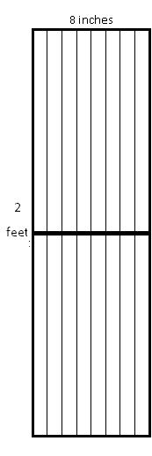
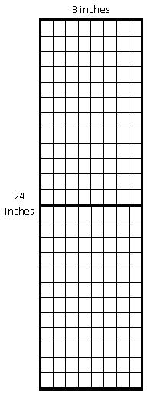
Find the figure that has the measurements 8 inches by 2 feet.
Convert the units so that inches are used for both length and width.
Notes:
Lesson 1 TD 6

Slide 8
Verify the perimeter is 16 ft.
Then determine the area and record it in the table.
13
14
9
10
11
12
1
A
7
1
B
5
2
2
8
8
2
2
6
10
14
6
3
9
4 ft
7
6 ft
3
4
4
10
10
4
4
8
12
16
8
5
11
13
4 ft
14
15
16
6
6
12
12
15
2 ft
16
Model | Length | Width | Perimeter | Area
A
B
6 ft.
2 ft.
16 ft.
12 ft.²
4 ft.
4 ft.
16 ft.
16 ft.²
Notes:
Lesson 1 Practice and Reinforcement
For some reason the very last animation will not work. In play mode, it will not insert the 16ft.² into the chart.

