Slide 1
National Center and State Collaborative
(NCSC) Sample Items Overview 2015
Notes:
The National Center and State Collaborative (NCSC) is a project led by five centers and 24 states (Tier 1 and Tier 2) including Washington, D.C. and the Pacific Assessment Consortium to build an alternate assessment based on alternate achievement standards (AA-AAS) for students with significant cognitive disabilities.
This presentation will provide an overview of NCSC’s sample items.

Slide 2
Session Overview
NCSC Alternate Assessment Design
Taking a Closer Look: Item Types and the Characteristics of the various items
Overview of NCSC Sample Items (English Language Arts and Mathematics only)
Notes:
This session will highlight the NCSC Assessment Design including item types and characteristics and an annotated overview of the NCSC Sample items for English Language Arts and Mathematics.

Slide 3
National Center and State Collaborative (NCSC) Alternate Assessment Consortium
To develop a system of assessments supported by curriculum, instruction, and professional development to ensure that students with the most significant cognitive disabilities achieve increasingly higher academic outcomes and leave high school ready for post-secondary options.
Notes:
The goal of the National Center and State Collaborative (NCSC) is to ensure that students with the most significant cognitive disabilities achieve increasingly higher academic outcomes and leave high school ready for post-secondary options.
NCSC defines a comprehensive system that will coherently address curriculum, instruction, and assessment needs in states by:
1) producing technically defensible formative, interim, and summative assessments;
2) incorporating evidence-based instruction and curriculum models; and
3) developing comprehensive approaches to professional development (PD).

Slide 4
NCSC Alternate Assessment
Summative Assessment
  (March 30 through May 15, 2015)
Math and ELA including Writing
  Grades 3-8 and Grade 11
Notes:
The NCSC Alternate Assessment based on Alternate Achievement Standards is a summative assessment. The operational test is March 30 through May 15, 2015 and will assess mathematics and ELA including writing for Grades 3 though 8 and Grade 11.

Slide 5
Assessment Design
Online Platform (computer-based)
Item Types are:
  Selected response and constructed response
    Math constructed response at various grade levels
    Writing both selected and constructed response
Items of varying complexity
Scripted Directions for Test Administrators
Notes:
The NCSC Alternate Assessment Design is a computer-based assessment that will be administered through an online platform for which students will interact with items presented on the computer.
The item types are: selected response, students will choose their answer choice by selecting from 2 or 3 answer options, and
constructed response, students will be asked to perform and complete a task and the test administration will score the item using a rubric.
The mathematics sessions also have constructed response items at various grade levels.
The reading sessions are selected response items, and for the writing content, there are both selected response and constructed response items.
Specific directions are provided in the Directions for Test Administration (DTA).
Items have been developed with varying levels of complexity.
For all items, there are scripted directions that must be read and followed by all test administrators.

Slide 6
NCSC Item Development and Item Complexities
The NCSC items were developed at varying degrees of complexity that measure the same academic skill.
In order to know more about the characteristics of the students that participate in Alternate Assessments the Learner Characteristic Inventory (LCI) was administered.
The data from the LCI was incorporated into the development and complexities used to create each item.
Notes:
NCSC Item Development and Item Complexities
The NCSC items were developed at varying degrees of complexity that measure the same academic skill.
In order to know more about the characteristics of the students that participate in alternate assessments, the Learner Characteristic Inventory or LCI was administered to their students by all NCSC states.
The data from the LCI was incorporated into the item development and the complexities used to create each item.

Slide 7
Principled Design
    Variable Features are written into the tasks (implemented) to support the integration of UDL:
      Aspects of assessment tasks that can be varied in order to control difficulty or target emphasis of the knowledge, skills and abilities
      UDL Categories: Receptive, Expressive, Language and Symbols, Cognitive, Executive, Affective
    The embedded variable features allow the assessment to measure the academic skills that all students with significant cognitive disabilities have acquired.
Notes:
The Principled Design
Variable features are written into the tasks to support the integration of Universal Design for Learning. Variable features included aspects of the assessment tasks that can be varied in order to control difficulty or target the emphasis of the knowledge, skills and abilities.
These embedded variable features allow the assessment to measure the academic skills that all students with significant cognitive disabilities have acquired.

Slide 8

Learner Characteristic Inventory
Categories
Age, Grade
Primary IDEA disability category
EL status, Primary language
Classroom Setting
Communication
Expressive
AAC Use
Receptive
Engagement
Vision, Hearing, Motor function, Health issues/attendance
Reading & Mathematics
Notes:
NCSC States administered the Learner Characteristic Inventory (LCI) which provided characteristics of the students that participated in State’s Alternate Assessment.
NCSC then utilized this information as part of the NCSC Assessment items.
The LCI is teacher reported. The LCI describes characteristics of their students in the areas of reading, mathematics, and communication.
Data from the LCI, across the NCSC states and in the Pilots were very similar. Meaning teachers reported characteristics of students that participate in alternate assessments as similar from one state to another as reported from NCS LCI Project Results Presentation dated 8-2-12.
The categories include: age, grade, primary IDEA disability, EL status, primary language, classroom setting, communication including expressive, receptive, AAC use and engagement, vision, hearing, motor function, health issues, attendance, and reading and mathematics.

Slide 9
Reading (from all NCSC States)
Notes:
This is data from all NCSC States in the area of reading.
The range of characteristics are: Reads fluently with critical understanding, reads fluently with basic literal understanding, reads basic sight words in print/Braille, aware of text/Braille, no observable awareness of print/Braille and not specified.
About 39% of students are able to read basic sight words in print or Braille. 22% of students can read fluently with basic literal understanding in print or in Braille and 4% of students are able to read fluently with critical understanding. This means that about 75% of students are able to engage with reading.
Also noteworthy, is about 16% of these students have no observable awareness of print/Braille.

Slide 10
Math (from All NCSC States)
Notes:
This is data from all NCSC States: in the area of mathematics.
The range of characteristics are applies procedures to solve real life or routine word problems from a variety of contexts, does computational procedures with or without a calculator, counts with 1 to 1 correspondence to at least 10 and/or makes numbered sets of items, counts by rote to 5, and no observable awareness or use of numbers.
About 42% of students are able to do computational procedures with or without a calculator. And an additional 26% can count with 1 to 1 correspondence to at least 10, and/or make numbered sets of items.
And about 15% have no observable awareness or use of numbers.

Slide 11
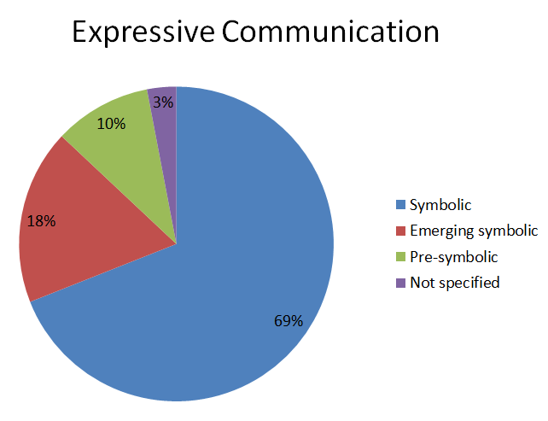
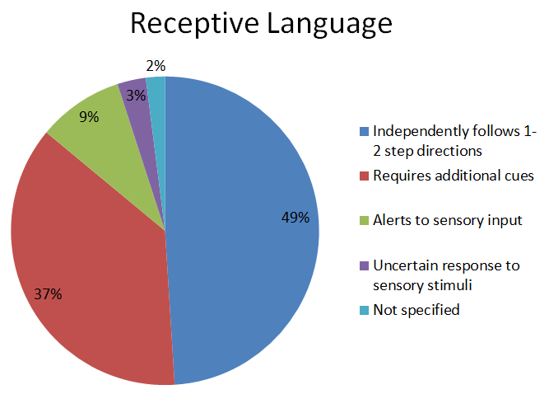
Communication (from all NCSC Partner States)
Notes:
In the areas of Communication:
Expressive: 69% of students can expressively communicate symbolically. 18% are emerging symbolic communicators, 10% are pre-symbolic, and 3% is not specified.
Receptive Communication: 49% of students independently follow 1 - 2 step directions, 37% require additional cues, 9% alert to sensory input, 3% have uncertain responses to sensory stimuli, and 2% not specified.

Slide 12
Item Complexities
Each content standard is assessed by items written at various levels of complexity.
For example, in mathematics, some items use only mathematical notation and other items accompany the notation with a visual model of its meaning.
Notes:
The selected sample items are not intended to demonstrate the depth and complexity of items students will see during the NCSC Operational Assessment. The sample items selected for the grade level bands highlight various complexity levels of one targeted standard and Core Content Connector. In addition, the selected sample items highlight the embedded supports (i.e., demonstration of task, statements reminding students what the task will be about, simplified language and visual supports).
It is important to note students will not be administered all complexity levels for each standard and students will be administered items that may be at a more complex level than they typically see in their instruction.
Each content standard is assessed by items written at various levels of complexities. For example, in mathematics, some items use only mathematical notation and other items accompany the notation with visual models of its meaning.

Slide 13
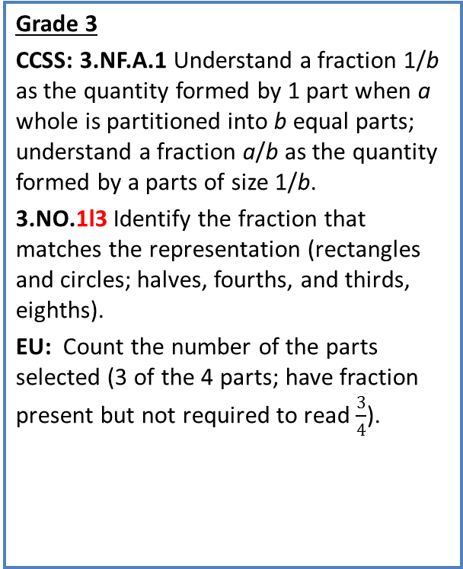
Mathematics (Standards)
Grade 3
CCSS: 3.NF.A.1 Understand a fraction 1/b as the quantity formed by 1 part when a whole is partitioned into b equal parts; understand a fraction a/b as the quantity formed by a parts of size 1/b.
3.NO.1l3 Identify the fraction that matches the representation (rectangles and circles; halves, fourths, and thirds, eighths).
EU: Count the number of the parts selected (3 of the 4 parts; have fraction present but not required to read $\frac{3}{4}$).
Grade 6
CCSS: 6.EE.C.9 Use variables to represent two quantities in a real-world problem that change in relationship to one another; write an equation to express one quantity, thought of as the dependent variable, in terms of the other quantity, thought of as the independent variable. Analyze the relationship between the dependent and independent variables using graphs and tables, and relate these to the equation.
CCC: 6.ME.2a2 Solve one-step real world measurement problems involving unit rates with ratios of whole numbers when given the unit rate (3 inches of snow falls per hour, how much in 6 hours).
Grade 11
CCSS: HSS-ID.A.2 Use statistics appropriate to the shape of the data distribution to compare center (median, mean) and spread (interquartile range, standard deviation) of two or more different data sets.
CCC: H.DPS.1c1 Use descriptive stats; range, median, mode, mean, outliers/ gaps to describe data set.
EU: Identify the highest and lowest value in a data set given a number line and matching symbols (concept of range).
Notes:
The following sample items are based on these Standards for Grade 3, Grade 6 and Grade 11.
In Grade 3 the item focus is on fractions or fraction parts and you will see one sample item that focuses on the essential understanding: counting the number of parts selected.
In Grade 6 the item focus is on real world measurement problems involving unit rates with ratios.
And in Grade 11 the item focus is on descriptive stats; including range, median, mode, mean, outliers/gaps to describe a data set. And you will see another item that focuses on the essential understanding: identifying the highest and lowest value in a data set given a number line and matching symbols.

Slide 14
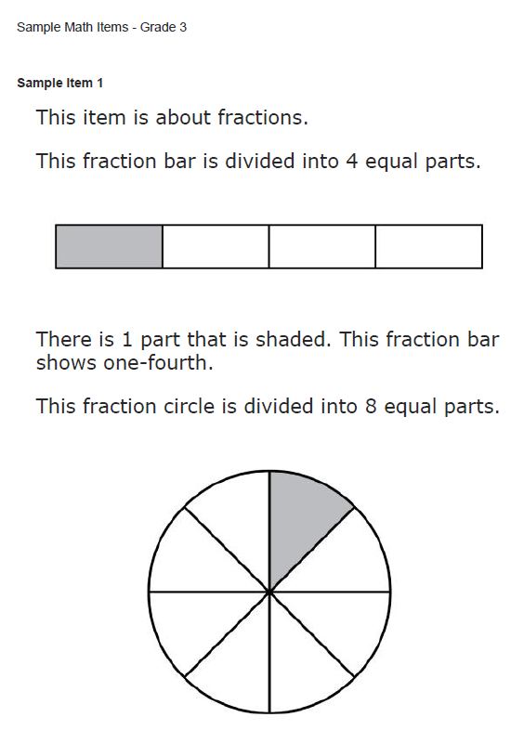
Mathematics Grade 3 Sample Item 1
Statement reminding students what the item is about
Demonstration
Simplified Language
Notes:
This is a Grade 3 math item.
Sample Item 1. Each test will also include the Directions for Test Administration (DTA) that will provide a script and directions of what to include or point to while administering the items.
(Read entire item).
This item begins with a statement reminding the student what the item is about. (Fractions).
Simplified language is also included.
This item has a demonstration included to walk the student through how to do the item and then the test items begins with “This fraction circle is divided into 8 equal parts.”

Slide 15
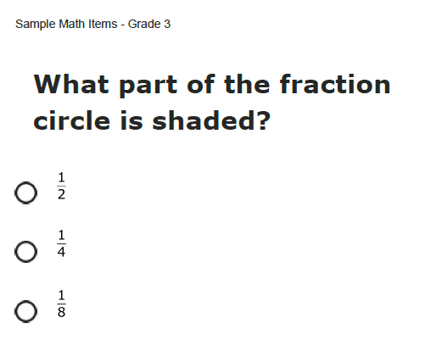
Mathematics Grade 3 Sample Item 1
3 Answer Options
Notes:
The question is “What part of the fraction circle is shaded?”
There are three answer options to choose from.
Note: The actual items in the test have both the radial buttons and answer tiles, so that the student can click anywhere in the answer tile to records his/her response.

Slide 16
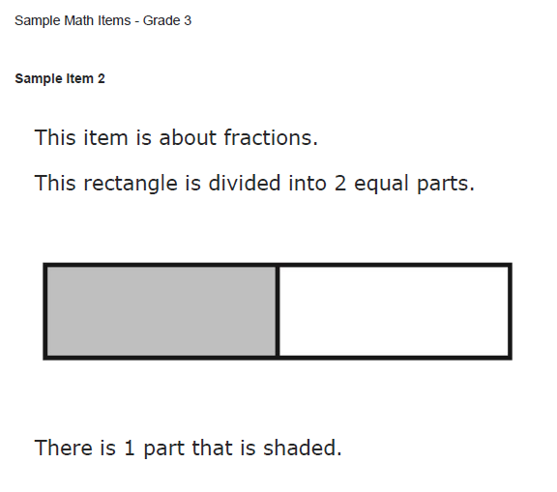
Mathematics Grade 3 Sample Item 2
Statement reminding students what the item is about
Simplified Language
Notes:
This is another Grade 3 math item.
Sample Item 2.
(Read entire item).
This item begins with a statement reminding the student what the item is about. (Fractions).
Simplified language is also included. Less words and graphics and also notice simplified parts.
This item has a demonstration included to walk the student through how to do the item.

Slide 17
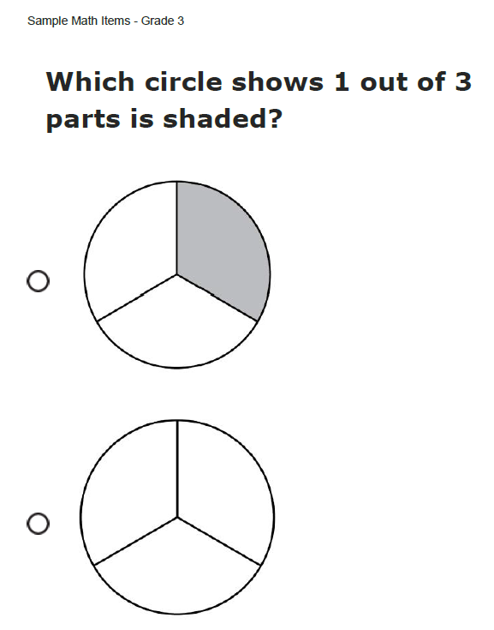
Mathematics Grade 3 Sample Item 2
2 Answer Options
Notes:
The question is “What circle shows 1 out of 3 parts shaded?”
There are two answer options to choose from and include visual representations in the answer options.
This second items is a lower complexity level than the previous one.
You have now seen 2 items in Grade 3 with varying complexity levels connected to the same standard.

Slide 18
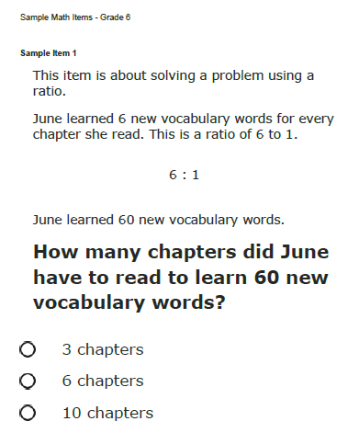
Mathematics Grade 6 Sample Item 1
Added context and language
Statement reminding students what the item is about
Mathematical Notation only
3 Answer Options
Notes:
This is a Grade 6 math item.
Sample Item 1. Each test will also include the Directions for Test Administration (DTA) that will provide a script and directions of what to include or point to while administering the items.
(Read entire item).
This item begins with a statement reminding the student what the item is about. (Solving a problem using a ratio).
There is added context and language, notice the only a mathematical notation and double digit figures, straight forward presentation does not include a demonstration.
The question is “How many chapters did June have to read to learn 60 new vocabulary words?”
There are three answer options to choose from.
This is a more complex item.

Slide 19
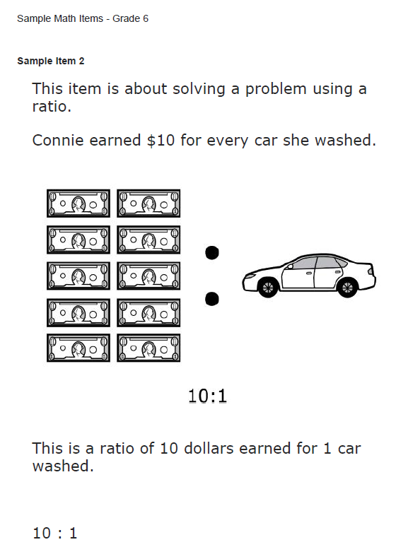
Mathematics Grade 6 Sample Item 2
Statement reminding students what the item is about
Mathematical notation and visual representation
Simplified Language
Notes:
This is a Grade 6 math item.
Sample Item 2. (Read entire item).
This item begins with a statement reminding the student what the item is about. (Solving a problem using a ratio).
There is a demonstration walking the student through the steps to solve this type of problem.
This item also includes the mathematical notation and visual representation.

Slide 20
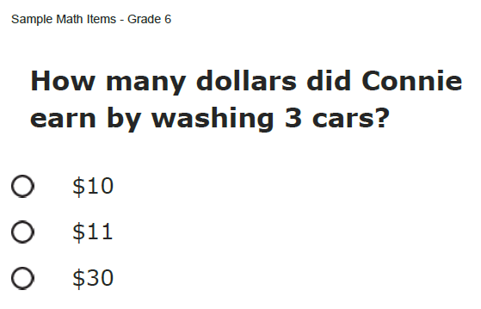
Mathematics Grade 6 Sample Item 2
3 Answer Options
Notes:
The question is “How many dollars did Connie earn by washing 3 cars?”
There are three answer options to choose from.
This is an example of a lower complexity level than the previous item.

Slide 21
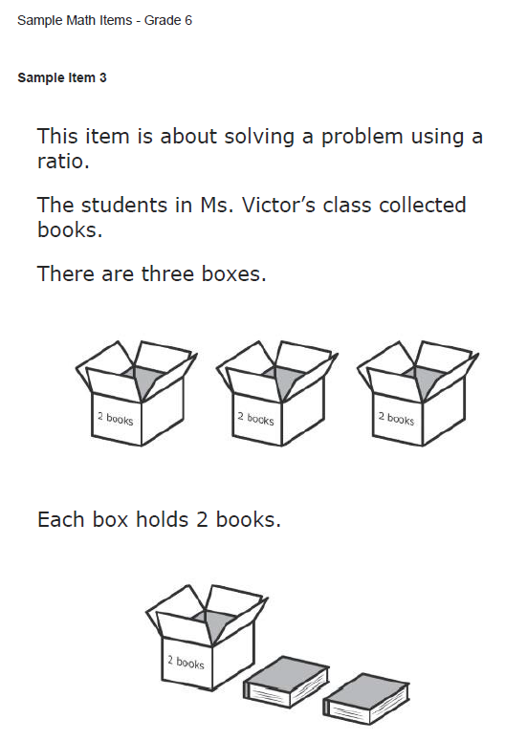
Mathematics Grade 6 Sample Item 3
Statement reminding students what the item is about
Visual Supports
Simplified Language
Notes:
This is a Grade 6 math item.
Sample Item 3. (Read entire item).
This item begins with a statement reminding the student what the item is about. (Solving a problem using a ratio).
There is a demonstration walking the student through the steps to solve this type of problem and added visual supports with simplified language.

Slide 22
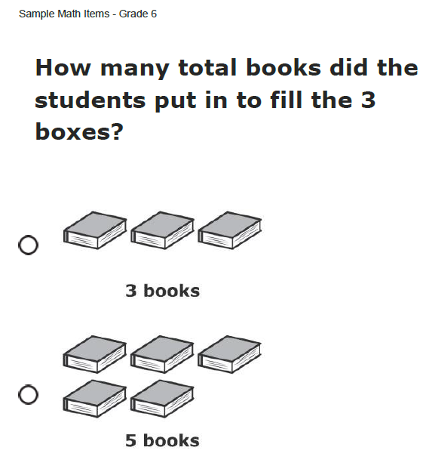
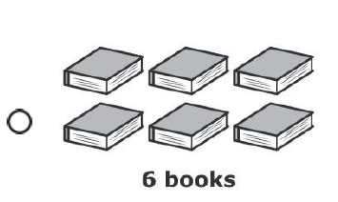
Mathematics Grade 6 Sample Item 3
Visual Supports in Answer Choices
3 Answer Options
Notes:
The question is “How many total books did the students put in to fill the 3 boxes?”
There are three answer options to choose from with visual supports.
This of lower complexity than the previous item.
You have now seen 3 items in Grade 6 with varying complexity levels connected to the same standard.
Reminder: scrolling down the remainder of page or zooming in may be necessary in order for all of the answer options to be revealed.

Slide 23
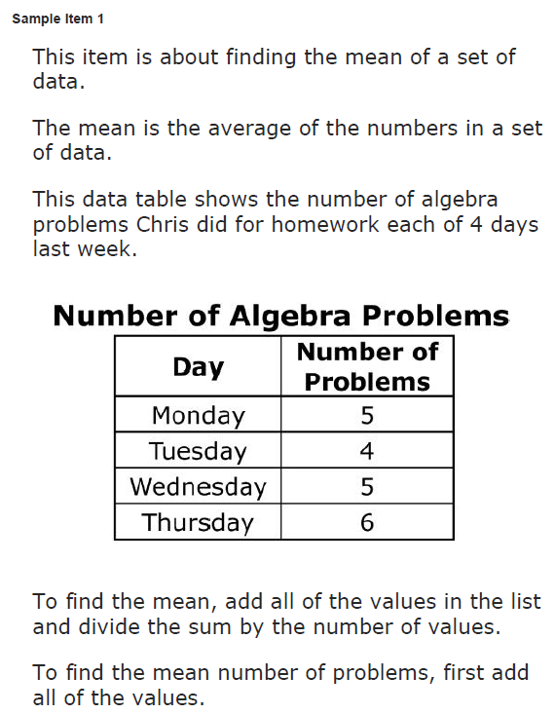
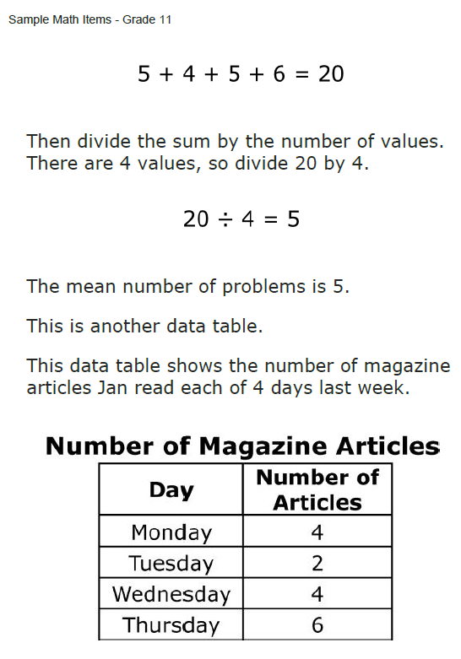
Mathematics Grade 11 Sample Item 1
Demonstration
Statement reminding students what the item is about
Demonstration
Notes:
This is a Grade 11 math item.
Sample Item 1. (Read entire item).
This item begins with a statement reminding the student what the item is about. (Finding the mean of a set of data).
There is a demonstration walking the student through the steps to solve this type of problem. Notice the multi-steps and single digit numbers and simple computational procedures. The question begins by providing an explanation of the data the student will use to complete the item.

Slide 24
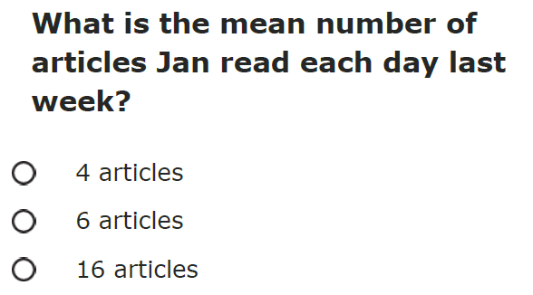
Mathematics Grade 11 Sample Item 1
3 Answer Options
Notes:
The question is “What is the mean number of articles Jan read each day last week?”
There are three answer options to choose from.
This is a more complex item.
Note: We do expect that there will be some students that will be able to interact, engage and complete this item. We should see more and more students able to show what they know and can do especially when teachers utilize the NCSC instructional resources and supports.

Slide 25
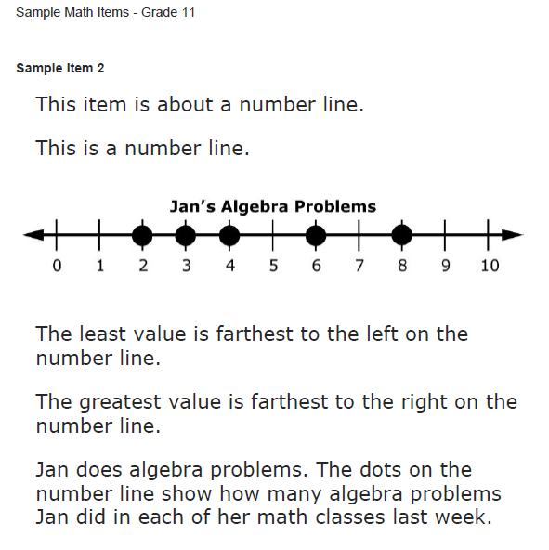
Mathematics Grade 11 Sample Item 2
Statement reminding students what the item is about
Demonstration
Simplified Language
Notes:
This is a Grade 11 math item.
Sample Item 2. (Read entire item).
This item begins with a statement reminding the student what the item is about. (Identify the highest and lowest value in a data set given a number line).
There is a demonstration walking the student through the steps to solve this type of problem.
You have now seen two items in Grade 11 with varying complexity levels connected to the same standard.

Slide 26
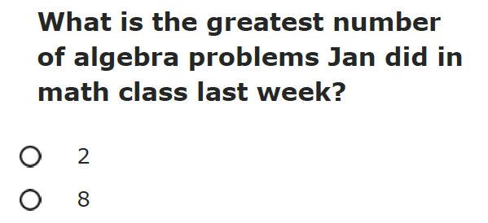
Mathematics Grade 11 Sample Item 2
2 Answer Options
Notes:
The question is “What is the greatest number of algebra problems Jan did in her math class last week?”
There are two answer options to choose from.
This is another example of a lower complexity level item. Still, notice the academic language used: greatest, farthest, right, left.

Slide 27
Reading (Standards)
Grade 4
CCSS 4.RL 2 Determine a theme of a story, drama, or poem from details in the text; summarize the text.
CCC 4.RL.k2 Determine the theme of a story, drama, or poem; refer to text to support answer.
CCSS 4.RL 1 Refer to details and examples in a text when explaining what the text says explicitly and when drawing inferences from the text.
CCC 4.RL.i1 Refer to details and examples in a text when explaining what the text says explicitly.
Grade 8
CCSS 8.RI.8 Delineate and evaluate the argument and specific claims in a text, assessing whether the reasoning is sound and the evidence is relevant and sufficient; recognize when irrelevant evidence is introduced.
CCC 8.RI.k4 Identify an argument or claim that the author makes
CCSS 8.RI.1 Cite the textual evidence that most strongly supports an analysis of what the text says explicitly as well as inferences drawn from the text.
CCC 8.RI.j1. Use two or more pieces of evidence to support inferences, conclusions, or summaries of text.
Grade 11
CCSS 11-12.RI.1 Cite strong and thorough textual evidence to support analysis of what the text says explicitly as well as inferences drawn from the text, including determining where the text leaves matters uncertain.
CCC: 112.RI.b1 Use two or more pieces of evidence to support inferences, conclusions, or summaries from text.
CCSS 11-12.RI.6 Determine an author’s point of view or purpose in a text in which the rhetoric is particularly effective, analyzing how style and content contribute to the power, persuasiveness or beauty of the text.
CCC 1112.RI.d1 Determine the author's point of view or purpose in a text.
Notes:
The follow sample reading items are based on these Standards for Grade 4, Grade 8 and Grade 11.
In Grade 4 the item focus is on determining a theme of a story, drama, or poem and refer to text to support an answer, refer to details and examples in text when explaining what the text says explicitly and when drawing inferences from text and refer to details and examples in text when explaining what the text explicitly says.
In Grade 8 the item focus is on identifying the argument and claim that the author makes, cite the textual evidence that most strongly supports an analysis of what the text says explicitly as well as inferences drawn from text, and use two or more pieces of evidence to support inferences, conclusions or summaries of text.
And in Grade 11 the item focus is on using two or more pieces of evidence to support inferences, conclusions, or summaries from text, determining an author’s point of view or purpose in a text in which the rhetoric is particularly effective; analyzing how style and content contribute to the power, persuasiveness or beauty of the text; and determining author’s point of view or purpose in a text.

Slide 28
Graduated Text Complexity of Reading Passages
Less Complex
More Complex
Most Complex
  Simple sentences
  Commonly used words
  Theme is obvious
  Clear events in order
  Predictable events
  Simple charts and tables
  Answers taken from the text
  Simple and compound sentences (i.e., and)
  Some grade level words
  Theme is clear
  Connections between ideas and events presented in order
  Charts and tables
  Answers drawn from the text
  Compound and complex sentences
  Grade level words
  Theme implied
  Connections between a range of ideas and events
  Charts and tables essential to understand text
  Answers inferred from the text
Notes:
This graphic explains characteristics of the reading passages in the sample items from the least complex to the most complex.
The least complex passages have simple sentences, commonly used words, theme is obvious, clear events in order, predictable events, simple charts and tables, and answers taken directly from the text.
More complex passages have simple and compound sentences, some grade level words, theme is clear, connections between ideas and events presented in order, charts and tables, and answers drawn from the text.
The most complex passages have compound and complex sentences, grade level words, theme is implied, connections between a range of ideas and events, charts and tables essential to understand text, and answers inferred from the text.
Note: In this presentation, there are no ELA sample items representing the lowest complexity level. An item at the lowest complexity level has characteristics similar to the math sample items for Grade 3 (sample item 2) on slides 16 and 17 and Grade 11 (sample item 2) on slides 25 and 26.

Slide 29
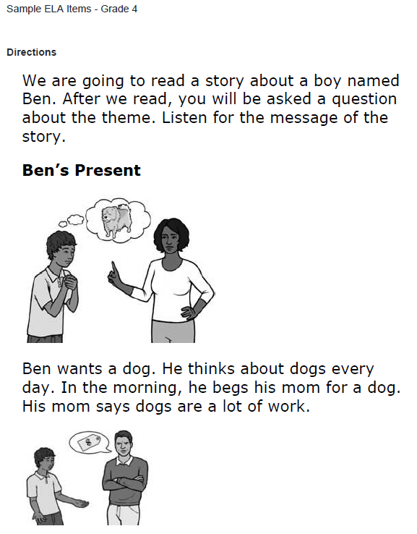
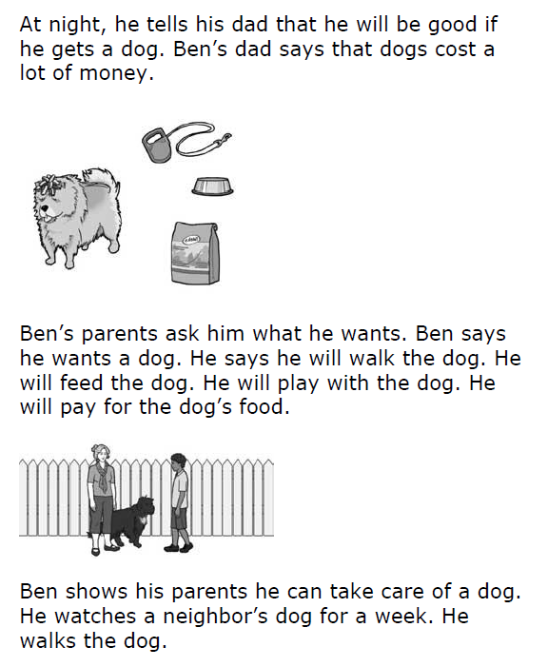
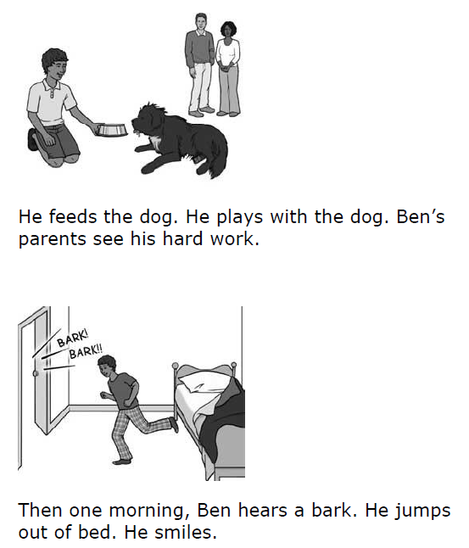
English Language Arts Grade 4 Sample Item 1
Statement reminding students what the item is about
Simple sentences
Visual Supports
Notes:
This is a Grade 4 Reading item.
Sample Item 1. (Read entire item).
This item begins with a statement reminding the student what the item is about. (Theme).
This passage contains simple sentence and visual supports embedded through out the reading passage in order to support the text.
This may be more text than a student is familiar with, the embedded support to read the passage again is an option.

Slide 30
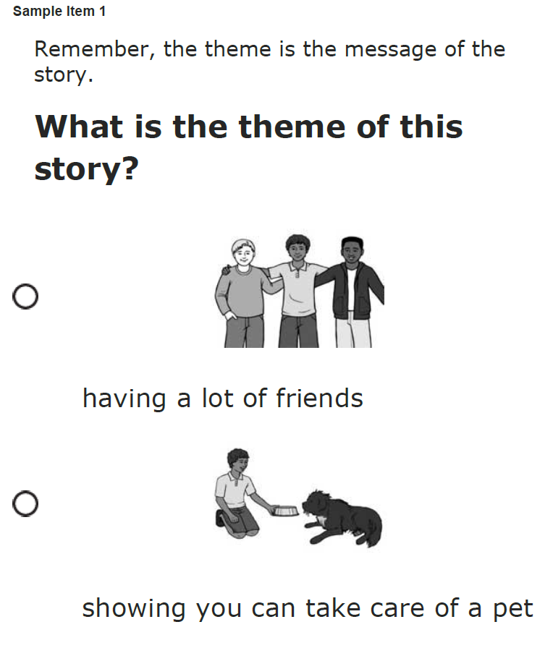
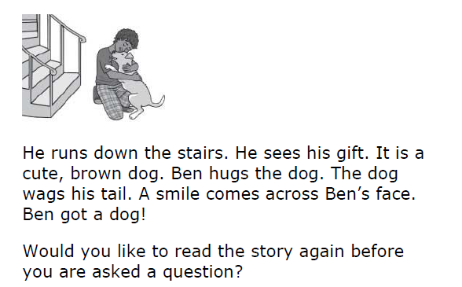
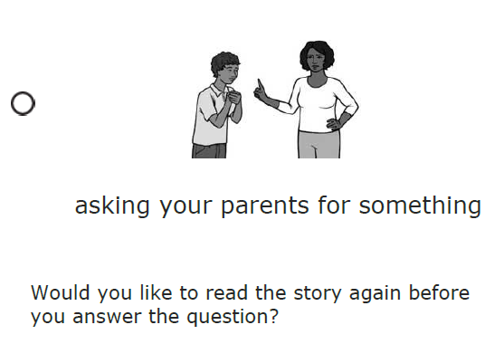
English Language Arts Grade 4 Sample Item 1
3 Answer Options with Visual Supports
Re-read passage or passage part
Notes:
This is a continuation of the previous passage. At the end of the passage the student is asked if they would like the passage reread before a question is asked.
A remember statement is included and defines the theme for the student in this context.
The question is “What is the theme of this story?”
There are three answer options to choose from with visual supports.
The only time a question will appear at the end of the entire passage is when the focus is about the entire passage (i.e., main idea, summary, theme, etc.)
Note: The font style and size are consistent throughout all passages, however for this presentation the font size does not appear the same. And the questions do not appear to the right of the passages. The question and answer options are displayed on separate pages from the passages.

Slide 31
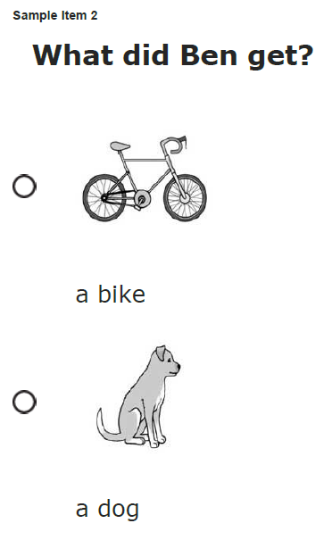
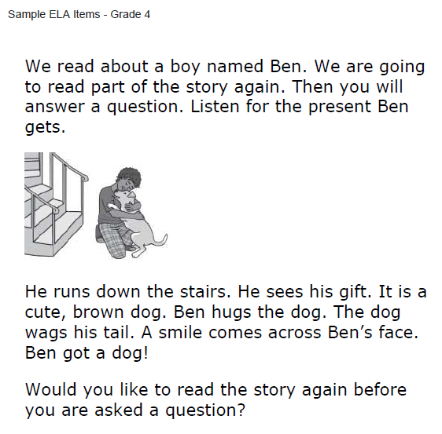
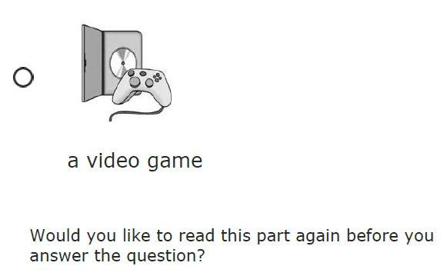
English Language Arts Grade 4 Sample Item 2
Passage part; same passage as previous example
Statement reminding students what the item is about
Visual Supports in Answer Options
Visual Supports
3 Answer Options
Simplified Language
Re-read passage or part
Notes:
This is a Grade 4 reading item.
Sample Item 2. (Read entire item).
This item is an example of a passage part from the same passage previously shown. The student is directed to part of the passage to answer an item. Just this part is “read” to the student and then a question (s) immediately follows the passage part.
This item begins with a statement reminding the student what the item is about. (About a boy named Ben….Listen for the present Ben gets).
The question is “What did Ben get?”
There are three answer options to choose from with visual supports. The visual supports in the answer options will not be a direct match to any of the visual supports embedded in the passages.
You have now seen 2 items in Grade 4 from the same passage connected to different standards.
Note: Sometimes the answer options are not all on the same page. Sometimes you may need to scroll down or zoom in order to reveal all answer options.

Slide 32
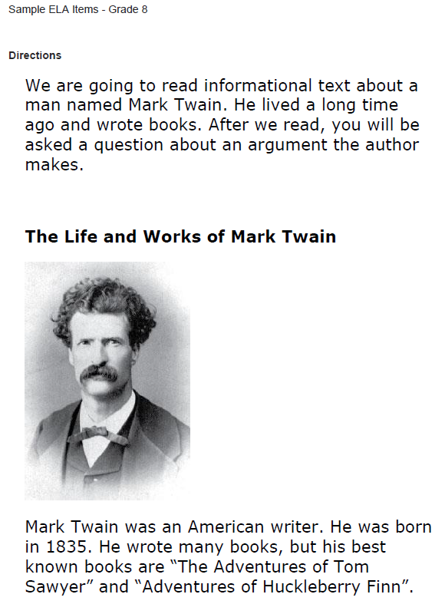
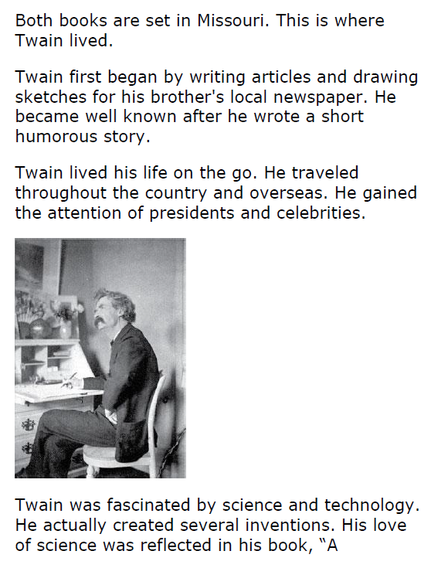
English Language Arts Grade 8 Sample Item 1
Compound sentences
Statement reminding students what the item is about
Visual Supports
Visual Supports
Compound and complex sentences
Notes:
This is a Grade 8 reading item.
Sample Item 1. (Read entire item).
This item begins with a statement reminding the student what the item is about. (An argument the author makes).
Visual supports embedded throughout the reading passage in order to support the text.
This passage contains compound and complex sentences and visual supports embedded through out the reading passage in order to support the text.
In this passage and in the upper grade levels, Informational Text is a major focus.
A student may need the test paused or resumed at the end of a read through of the entire passage and first question.

Slide 33
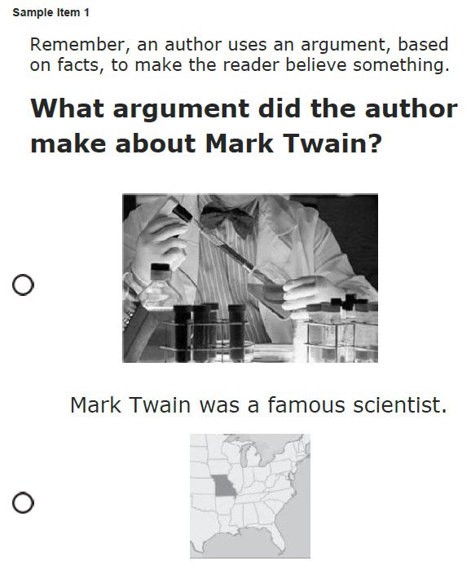
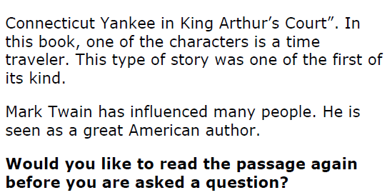
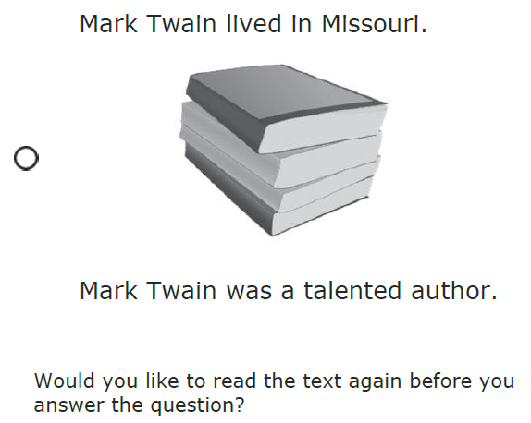
English Language Arts Grade 8 Sample Item 1
Statement reminding students what the item is about
Visual Supports in Answer Options
Re-read passage or part
3 Answer Options
Notes:
This is a continuation of the previous passage. At the end of the passage the student is asked if they would like the passage reread before a question is asked.
Test Administrators may need to use their professional judgment to determine if the question to reread should be presented to the student multiple times.
The question is “What argument did the author make about Mark Twain?”
A remember statement is included and defines the argument for the student in this context.
There are three answer options to choose from with visual supports.
The only time a question will appear at the end of the entire passage is when the focus is about the entire passage (i.e. main idea, summary, theme, etc.)
Note: The font style and size are consistent through out all passages, however for this presentation the font size does not appear the same. And the questions do not appear to the right of the passages. The question and answer options are displayed on separate pages from the passages.

Slide 34
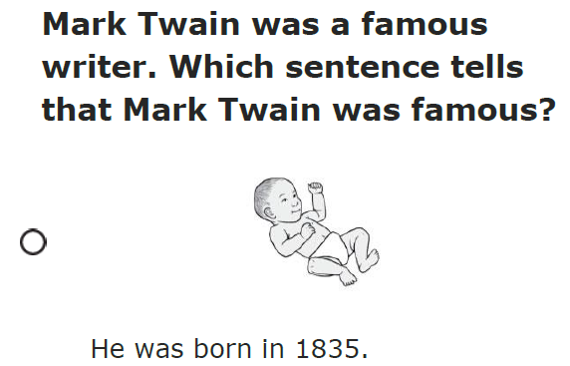
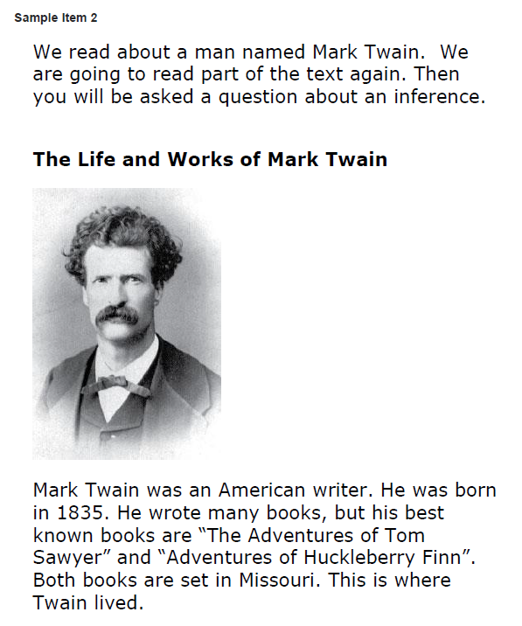
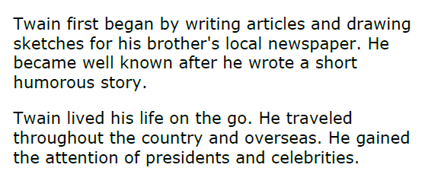
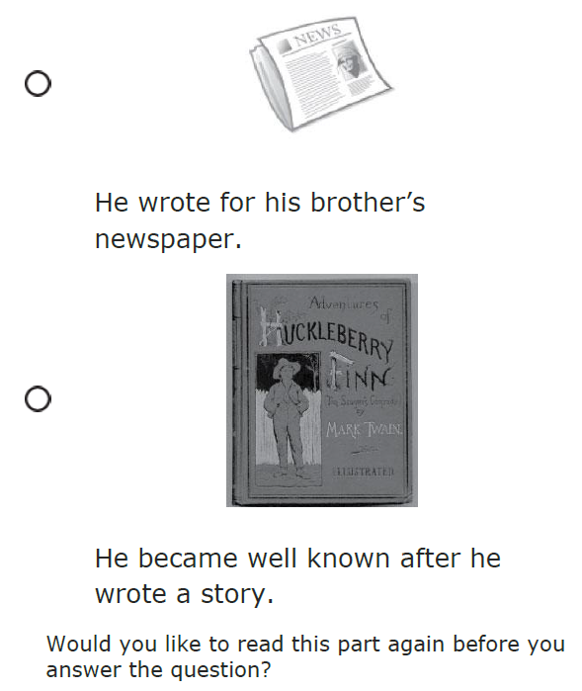
English Language Arts Grade 8 Sample Item 2
Passage part; same passage as previous example
Item about a passage part with a reminder statement
Statement reminding students about what the item is about
Visual Supports
Visual Supports in Answer Options
Simple and Compound Sentences
3 Answer Options
Notes:
This item is an example of a passage part from the same passage previously shown. The student is directed to part of the passage to answer an item. Just this part is “read” to the student and then a question(s) immediately following the passage part.
The question is “Which sentence tells that Mark Twain was famous?”
A statement at the end of the answer options is included. This is a test taking strategy.
There are three answer options to choose from with visual supports.

Slide 35
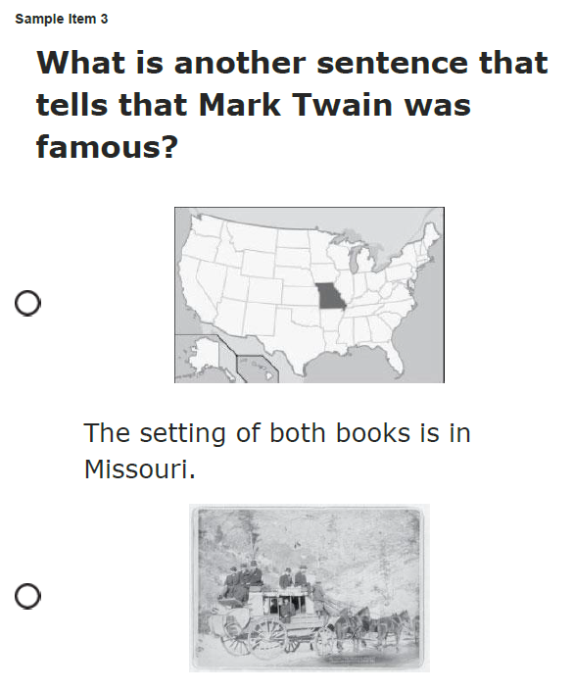
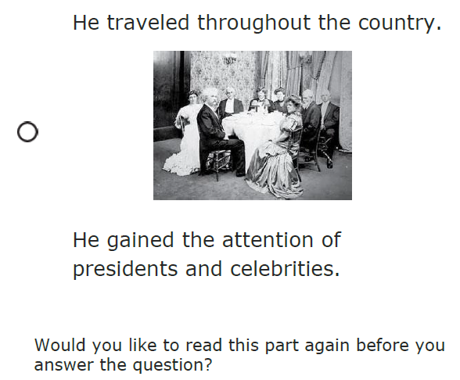
English Language Arts Grade 8 Sample Item 3
Second Question about passage and Answer Options
3 Answer Options
Visual Supports in Answer Options
Notes:
This item is an example of another passage part from the same passage previously shown. The second question from this passage part is
“What is another sentence that tells that Mark Twain was famous?”
There are three answer options to choose from with visual supports.
You have now seen 3 items in Grade 8 from the same passage connected to different standards.

Slide 36
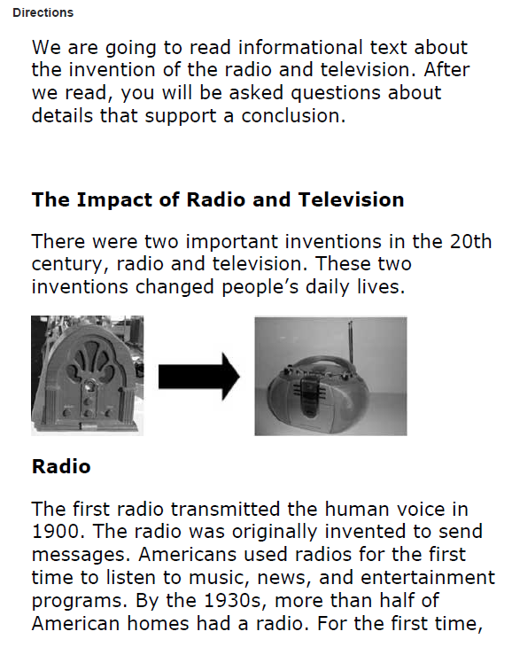
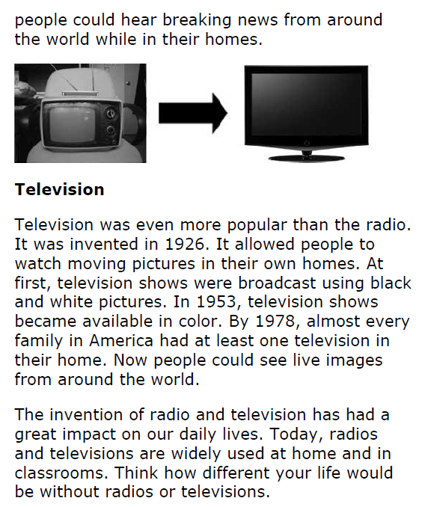

English Language Arts Grade11
Visual Supports
Statement reminding students about the what the item is about
Compound and complex sentences, some grade level words
Notes:
This is a Grade 11 reading item.
Sample Item 1. (Read entire item).
This item begins with a statement reminding the student what the item is about. (Details that support a conclusion).
Visual supports embedded throughout the reading passage in order to support the text.
This passage contains compound and complex sentences and visual supports embedded throughout the reading passage in order to support the text.
In this passage and in the upper grade levels, Informational Text is a major focus.
A student may need the test paused or resumed at the end of a read through of the entire passage and first question.

Slide 37
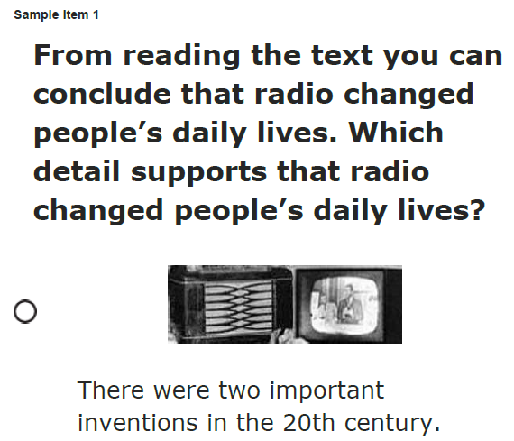
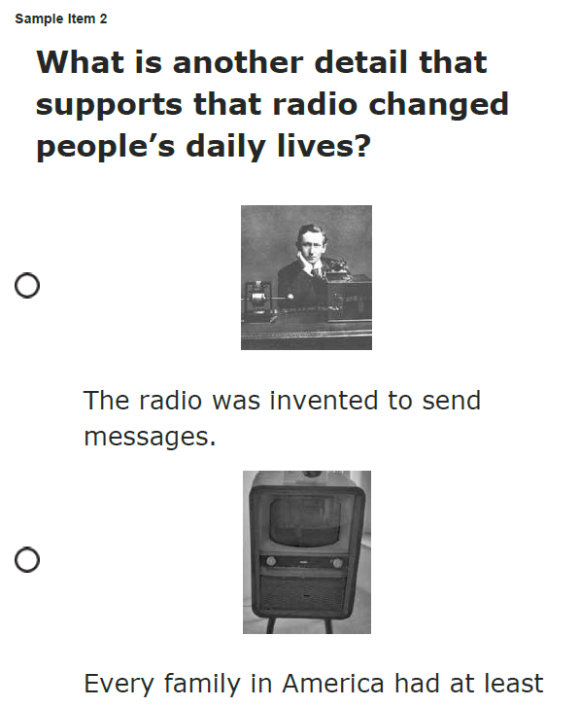
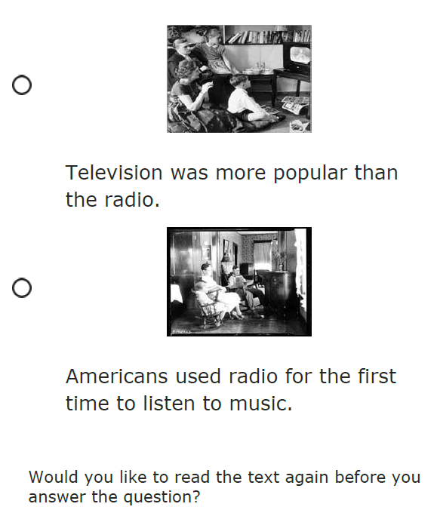
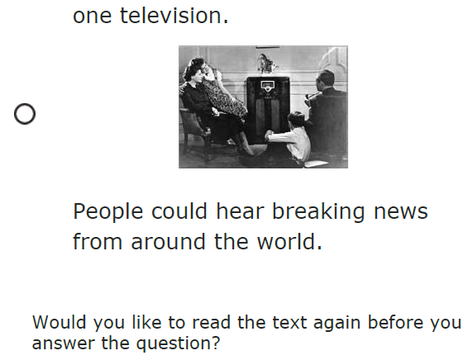
English Language Arts Grade 11 Sample Items 1 and 2
Statement reminding students what the item is about
3 Answer Options
Visual Supports in Answer Options
Notes:
This passage has two questions immediately following the passage.
The question is “Which detail supports that radio changed people’s daily lives?” and “What is another detail that supports that radio changed people’s daily lives?”
There are three answer options to choose from with visual supports. The visual supports in the answer options will not be a direct match to any of the visual supports embedded in the passages.

Slide 38

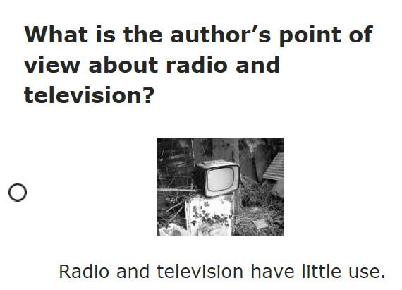
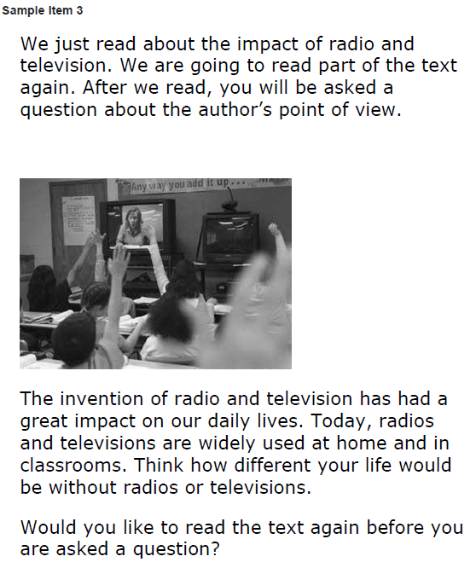
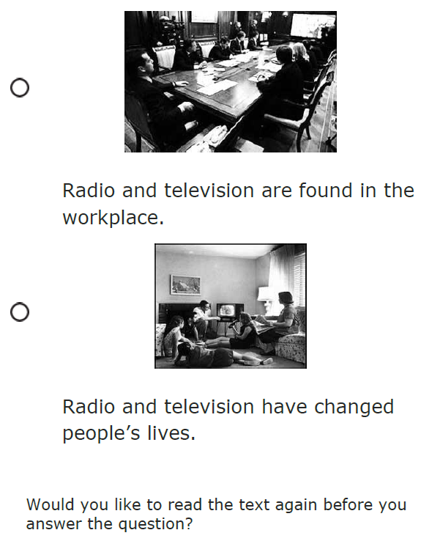
English Language Arts Grade11
Sample Item 3
Item about a passage part with a reminder statement
Passage part; same passage as previous example
Statement reminding student what the student just read and what the student will be looking for next
Visual Supports in Answer Options
3 Answer Options
Notes:
This item is an example of a passage part from the same passage previously shown. The student is directed to part of the passage to answer an item. At the beginning of the passage part, the student is reminded what was just read and after the passage part what the student will be looking for next. (The Author’s point of view).
The question includes a remember statement defining Author’s Point of View in this context.
The question is “What is the author’s point of view about radio and television?”
There are three answer options to choose from with visual supports.

Slide 39
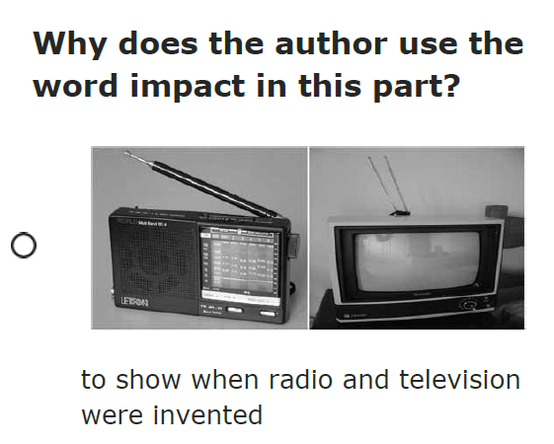
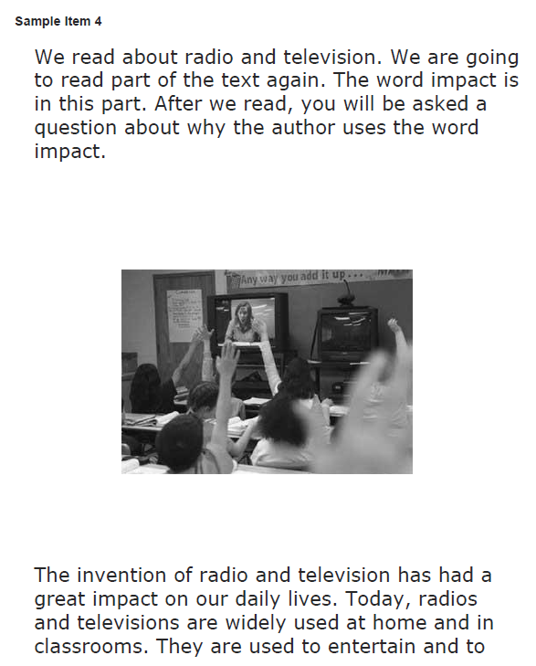
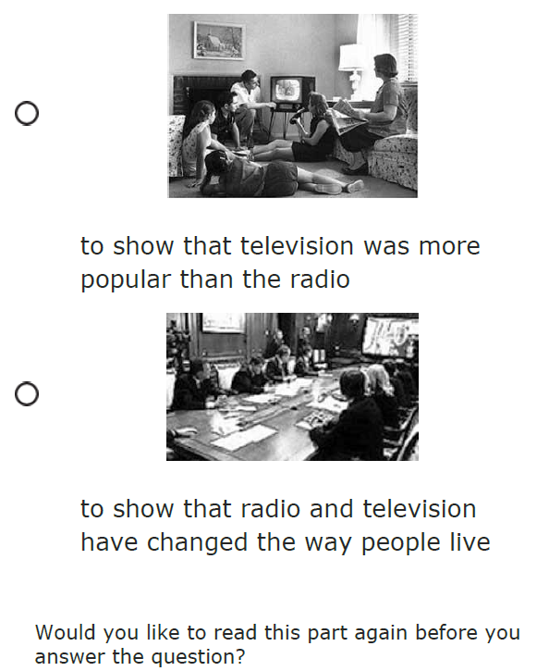

English Language Arts Grade11
Sample Item 4
Passage part; same passage as previous example
Statement reminding student what the student just read and what the student will be looking for next
Visual Supports in Answer Options
Compound and complex sentences, some grade level words
3 Answer Options
Notes:
This item is an example of a passage part from the same passage previously shown. The student is directed to part of the passage to answer an item. At the beginning of the passage part, the student is reminded what was just read and after the passage part what the student will be looking for next. (Author use of words in a passage).
The question is “Why does the author use the word impact in this part?”
You have now seen 4 items in Grade 11 from the same passage connected to different standards.
Note: The font style and size are consistent throughout all passages, however for this presentation the font size does not appear the same. And the questions do not appear to the right of the passages. The question and answer options are displayed on separate pages from the passages.

Slide 40
NCSC Findings That Informed The NCSC Item Design
The NCSC items give all students the opportunity to show what they know across content complexity.
The item design reflects the decision to ensure students can interact with content at varying complexity levels.
Notes:
The NCSC items give all students the opportunity to show what they know about across content complexity and this item design reflects the decisions to ensure students can interact with the content at varying complexity levels.
Reminder, in this presentation, there are no ELA sample items representing the lowest complexity level. An item at the lowest complexity level has characteristics similar to the math sample items for Grade 3 (sample item 2) on slides 16 and 17 and Grade 11 (sample item 2) on slides 25 and 26.

Slide 41
Assessing Writing
Scaffolded Support
Focus on idea development, organization and conventions
Uploading and/or submitting final writing product
Notes:
At this time there are no sample items for writing.
Writing will be assessed. The constructed responses will have scaffolded supports for students. The focus for writing is on idea development, organization and conventions.
Test administrators will support students by uploading and/or submitting the student’s final writing product.

Slide 42
Writing
Selected Response Items
  Test Writing Skills
  Full range of complexity represented
Writing Prompt
  Will be generated by student using selected responses
Notes:
The writing sessions will have selected responses that will focus on writing skills and the full range of complexity will be represented.
In addition students will complete a writing prompt. This will be generated by the student using selected responses that are presented to the student.
More information will be included in the both the training modules and Directions for Test Administration or DTA for test administrators.

Slide 43
Writing Materials
Has reference materials (cards to support student)
  Example: Good Writers….
  Will be scored using a rubric (will be not scored test administrators)
Notes:
There are writing reference materials (cards to support the student). A example is the Good Writers card that reminds that students what good writers do.
The writing items will be scored using a rubric and will not be scored by test administrators.

Slide 44
Writing: Uploading Evidence
Critically important the test administrator is aware the options for submitting the writing response(s) for students
  Upload evidence
  Transcribing
  Annotation
  *Additional information about these processes are in the NCSC Test Administration Manual and Training Modules
Notes:
Uploading evidence: It is critically important that the test administrator is aware of the options for submitting the writing response(s) for students. There is uploading evidence using scanning, or the embedded evidence capture tool, the accommodations of transcribing the student’s responses and annotating the student’s responses.
Additional information about these processes are in the NCSC Test Administration Manual (TAM) and training modules.

Slide 45
Questions ???
________ Department of Education Contact:
Name
Title
Phone number
Email
Notes:
This final slide contains your NCSC State Lead contact information. If you have any further questions, contact your state lead.

